Slide 1



Public Procurement & Government Spending in Nigeria
Data Analytics in Excel – End-of-Module Project
Presented by
AYODEJI FOLAKEMI OLAYEMI
13/08/2026
Excel End-of-Module Project • 2026

Slide 2
Presentation Overview
Project analytical process
01 Introduction & Project Objective
02 Data Cleaning
03 Formulas, Functions & Lookups
04 PivotTables, Charts & Dashboard
05 Findings, Recommendations & Conclusion
Ayodeji Folakemi Olayemi
2

Slide 3
01 Introduction & Project Objective
Public Procurement is an important part of government spending in Nigeria. Procurement can face challenges such as deleys, project abandonment .
PROJECT OBJECTIVE:
The main objective of this project is to analyze public procurement and government spending data in Nigeria and generate useful insight that can support better decision-making and improve procurement efficiency.
Clean and Prepared Data
Calculate Key Measures
Analyze Procurement Patterns
Identify Potential risk
Create Charts and interactive dashboard
Provide Recommendation
Ayodeji Folakemi Olayemi

Slide 4
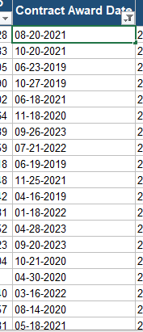
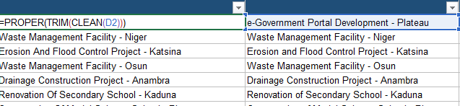
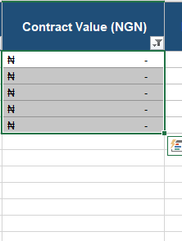
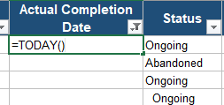

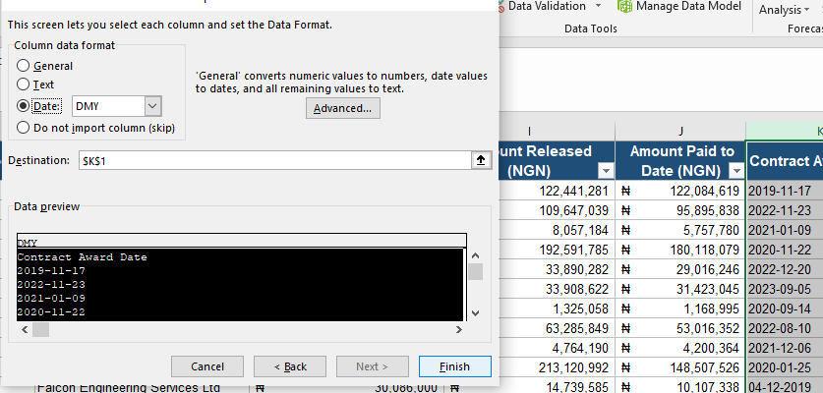
02. DATA CLEANING
The Data given contains Issues which is as follow:
Blanks
Missing Value
Mixed date formats
Inconsistent formatting
I used the following cleaning tools to clean my Data
PROPER,TRIM,CLEAN, Find & Replace, Remove Duplicates, Text to Columns and Data validation.
Ayodeji Folakemi Olayemi
3

Slide 5

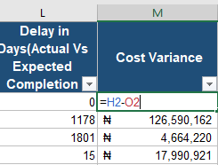

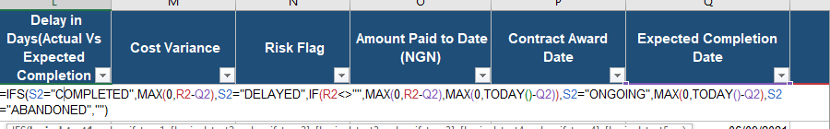
2. FORMULAS & CALCULATED FIELDS
Calculations used to measure funding and project performance
Financial Calculations
Project Performance & Risk
% Contract Released
% Contract Paid
Cost Variance
Delay in Days
IF / IFS / IFERROR
VLOOKUP / INDEX-MATCH
Ayodeji Folakemi Olayemi
4

Slide 6
3. PROCUREMENT PROBLEMS
Focus Areas
• Cost overrun & value-for-money
• Project abandonment & delay
• Procurement method & competition
• Contractor concentration
Ayodeji Folakemi Olayemi
5

Slide 7
4. PIVOTTABLES & ANALYSIS
Summarising contract value and contract count
KEY INSIGHT
PivotTables help compare spending by Sector, State, MDA, Fiscal Year and Procurement Method.
Ayodeji Folakemi Olayemi
Defence point: PivotTables make large datasets easier to summarise and compare.
6

Slide 8
5. KEY FINDINGS
01
02
03
Delayed & Abandoned Projects
Spending Patterns
Procurement & Contractor Risk
140 of 514 contracts (27%) are delayed or abandoned, tying up ₦25.9bn in commitments.
Works & Housing, Water Resources and Power are the three largest sectors, together over a third of the ₦99.1bn total contract value.
44% of value was awarded by Open Competitive Bidding, yet 18% went through Direct or Sole Sourcing outside open competition.
Ayodeji Folakemi Olayemi
7

Slide 9
7. CONCLUSION
Excel transforms raw procurement data into useful information for decision-making.
Clean → Calculate → Summarise → Visualise → Interpret → Recommend
Thank you
Ayodeji Folakemi Olayemi
9

Slide 10
6. RECOMMENDATIONS
1
1. Strengthen monitoring of delayed and abandoned projects.
2
2. Improve transparency of procurement, funding and project progress.
3
3. Monitor contractor concentration and procurement risks.
4
4. Use data dashboards for continuous management oversight.
Ayodeji Folakemi Olayemi
8

